Slide 1
CSE 417T Introduction to Machine Learning
Lecture 20 Instructor: Chien-Ju (CJ) Ho

Slide 2
Logistics
Homework 5 is due Apr 19 (Tuesday)
Exam 2 will be on April 28 (Thursday)
Will focus on the topics in the second half of the semester
Format / logistics will be similar to Exam 1
More details to come

Slide 3
Recap

Slide 4
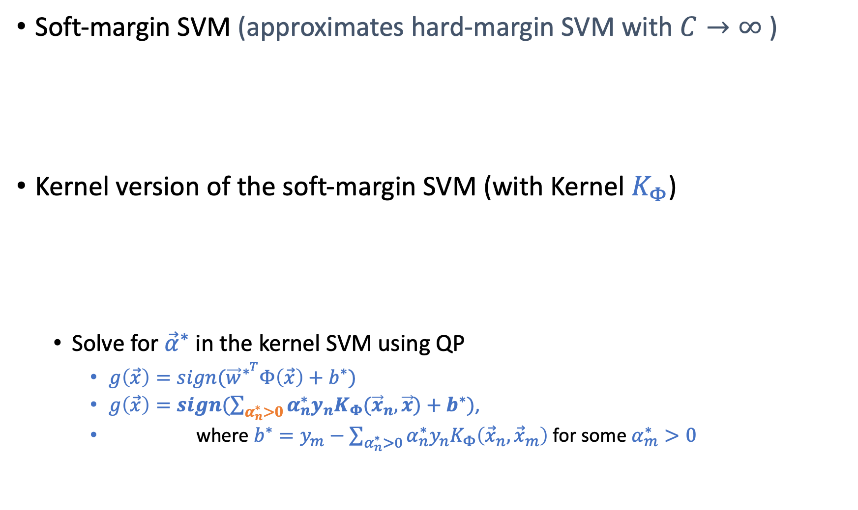
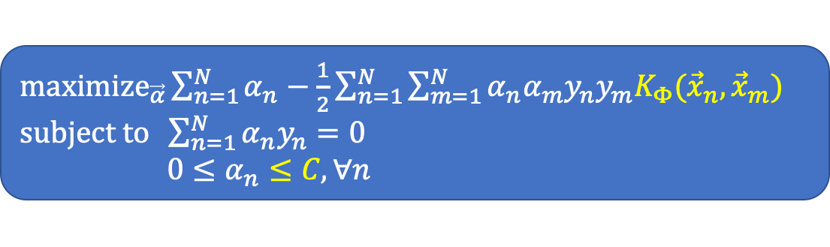
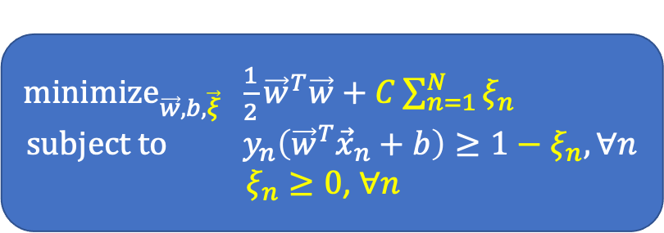
Support Vector Machines
Soft-margin SVM (approximates hard-margin SVM with $C→∞$)
Kernel version of the soft-margin SVM (with Kernel $K_{Φ}$)
Solve for ${\vec{α}}^{∗}$ in the kernel SVM using QP
$g\left(\vec{x}\right)=sign({\vec{w}}^{∗^{T}}Φ\left(\vec{x}\right)+b^{∗})$
$g\left(\vec{x}\right)=sign(\sum_{α_{n}^{∗}>0}{α_{n}^{∗}y_{n}K_{Φ}({\vec{x}}_{n},\vec{x})}+b^{∗})$,
where $b^{∗}=y_{m}−\sum_{α_{n}^{∗}>0}{α_{n}^{∗}y_{n}K_{Φ}\left({\vec{x}}_{n},{\vec{x}}_{m}\right)}$ for some $α_{m}^{∗}>0$
${\text{minimize}}_{\vec{w},b,\vec{ξ}} \frac{1}{2}{\vec{w}}^{T}\vec{w}+C\sum_{n=1}^{N}{ξ_{n}}$ $$\text{subject} \text{to} y_{n}\left({\vec{w}}^{T}{\vec{x}}_{n}+b\right)≥1−ξ_{n}, ∀n$$
$ξ_{n}≥0$, $∀n$
${\text{maximize}}_{\vec{α}}\sum_{n=1}^{N}{α_{n}}−\frac{1}{2}\sum_{n=1}^{N}{\sum_{m=1}^{N}{α_{n}α_{m}y_{n}y_{m}K_{Φ}({\vec{x}}_{n},{\vec{x}}_{m})}}$ $\text{subject} \text{to} \sum_{n=1}^{N}{α_{n}y_{n}=0}$ $0≤α_{n}≤C,∀n$

Slide 5
Neural Networks

Slide 6
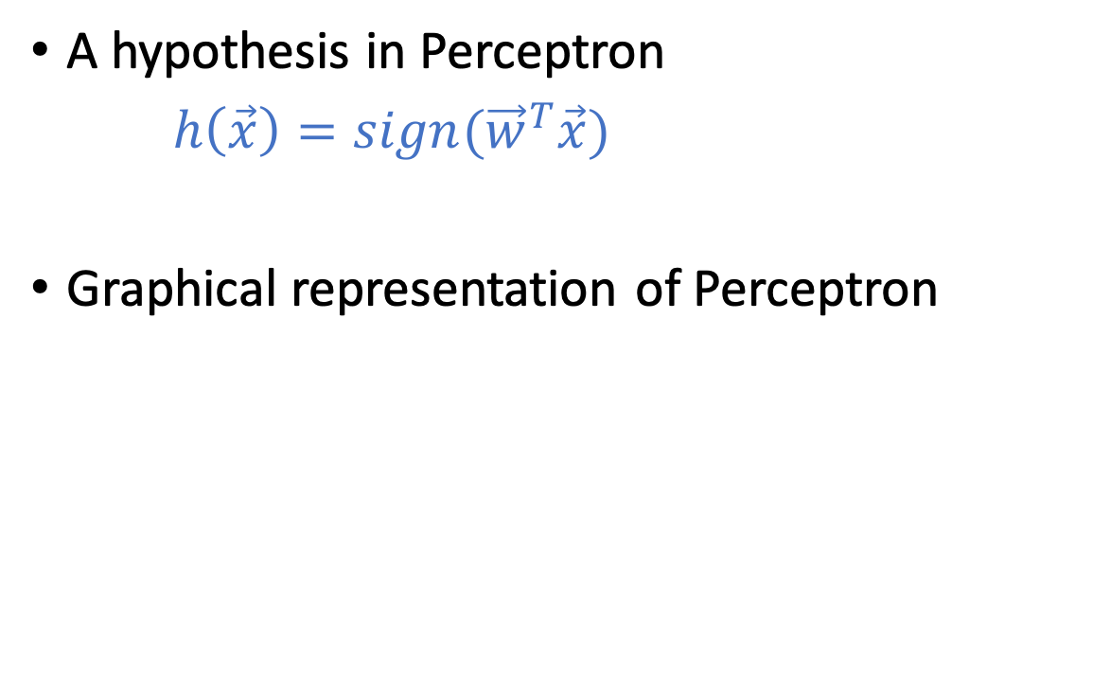
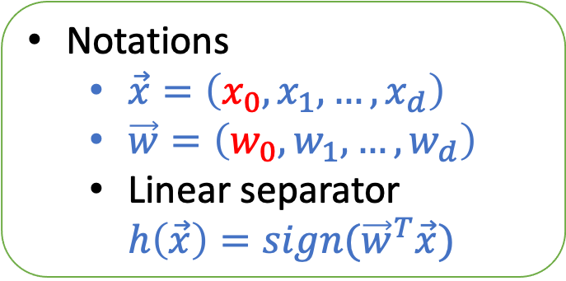
Perceptron
A hypothesis in Perceptron
$h\left(\vec{x}\right)=sign({\vec{w}}^{T}\vec{x})$
Graphical representation of Perceptron
Notations
$\vec{x}=\left(x_{0},x_{1},…,x_{d}\right)$
$\vec{w}=\left(w_{0},w_{1},…,w_{d}\right)$
Linear separator $h\left(\vec{x}\right)=sign({\vec{w}}^{T}\vec{x})$
Inspired by neurons:
The output signal is triggered when the weighted combination of the inputs is larger than some threshold

Slide 7
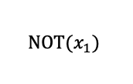
Implementing Logic Gates with Perceptron
0
-1
$$\text{NOT}(x_{1})$$
Impossible to implement XOR using a single perceptron

Slide 8
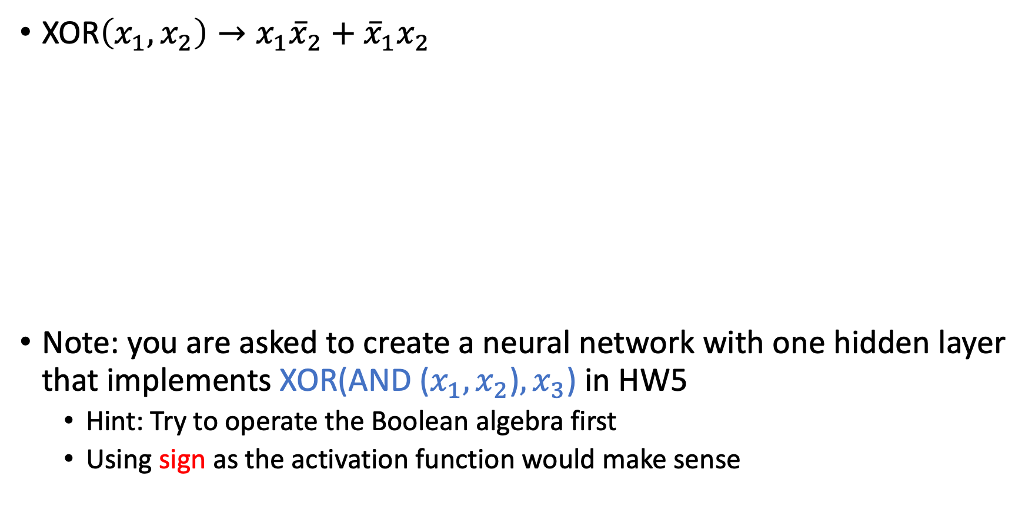
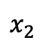
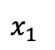
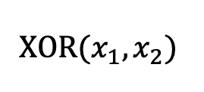
Multi-Layer Perceptron
XOR$\left(x_{1},x_{2}\right)→x_{1}{\overline{x}}_{2}+{\overline{x}}_{1}x_{2}$
Note: you are asked to create a neural network with one hidden layer that implements XOR(AND ($x_{1},x_{2}$)$,x_{3}$) in HW5
Hint: Try to operate the Boolean algebra first
Using sign as the activation function would make sense
$$\text{XOR}(x_{1},x_{2})$$
$$x_{1}$$
$$x_{2}$$

Slide 9
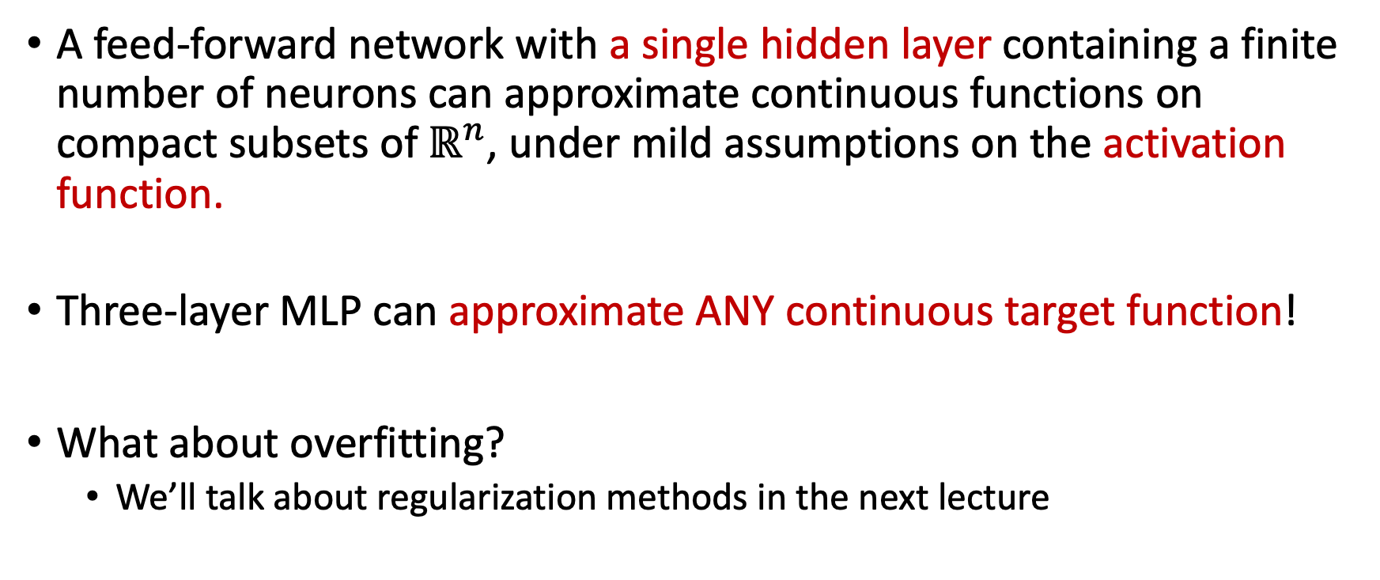
Universal Approximation Theorem
A feed-forward network with a single hidden layer containing a finite number of neurons can approximate continuous functions on compact subsets of$ℝ^{n}$, under mild assumptions on the activation function.
Three-layer MLP can approximate ANY continuous target function!
What about overfitting?
We’ll talk about regularization methods in the next lecture
Notes:
Activation function – non-constant, bounded, continuous

Slide 10
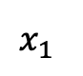
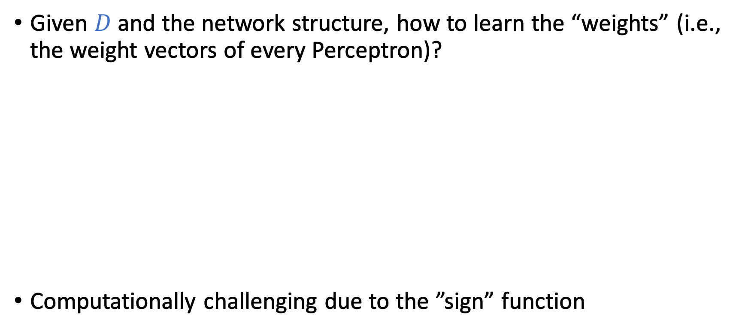
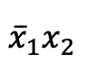
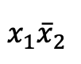
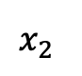
Learn MLP From Data?
Given $D$ and the network structure, how to learn the “weights” (i.e., the weight vectors of every Perceptron)?
Computationally challenging due to the ”sign” function
$$x_{1}$$
$$x_{1}{\overline{x}}_{2}$$
$$x_{2}$$
$${\overline{x}}_{1}x_{2}$$

Slide 11
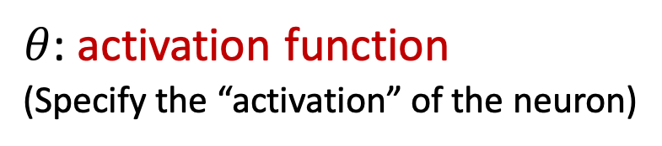
Neural Networks
A softened version of multi-layer Perceptron (MLP)
$θ$: activation function
(Specify the “activation” of the neuron)
(The activation function in the output layer is often separately considered)

Slide 12
Today’s Lecture
The notes are not intended to be comprehensive. They should be accompanied by lectures and/or textbook.
Let me know if you spot errors.
Notes:
This is the lecture I wish I have 6 chalkboards to utilize

Slide 13
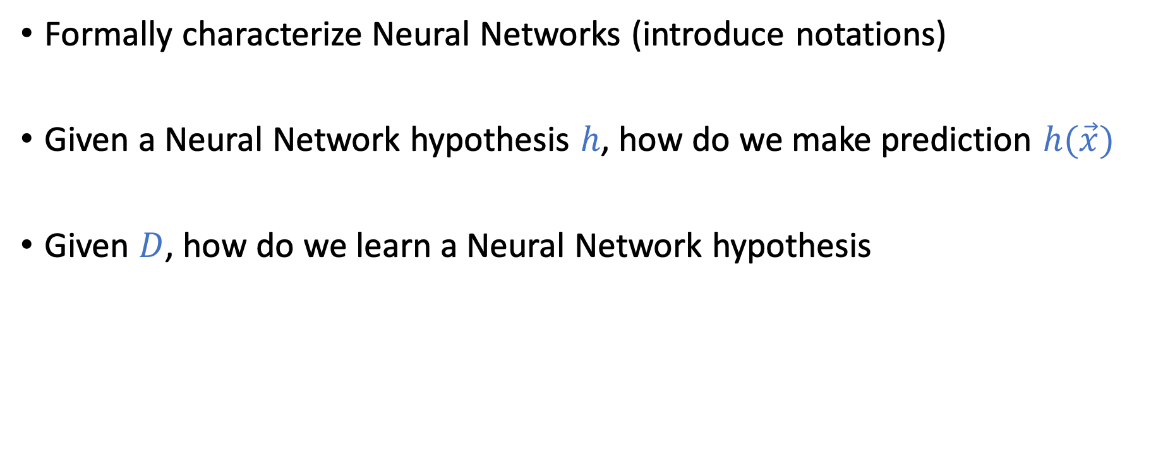
Goal of Today
Formally characterize Neural Networks (introduce notations)
Given a Neural Network hypothesis $h$, how do we make prediction $h(\vec{x})$
Given $D$, how do we learn a Neural Network hypothesis

Slide 14
Notations of Neural Networks (NN)

Slide 15

Neural Networks
$θ$: activation function
(Specify the “activation” of the neuron)
We mostly focus on feed-forward network structure

Slide 16
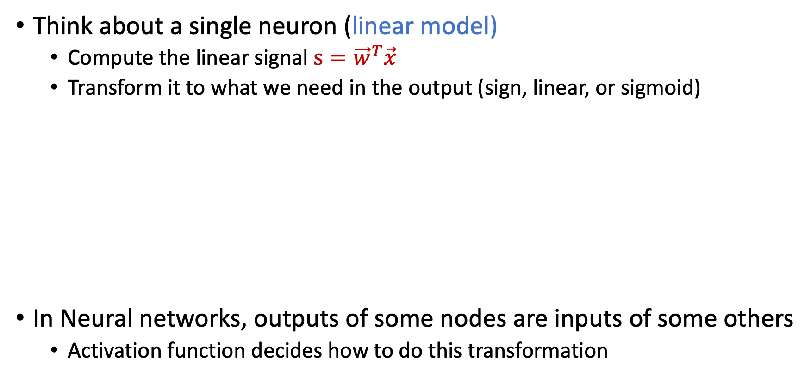
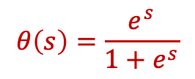
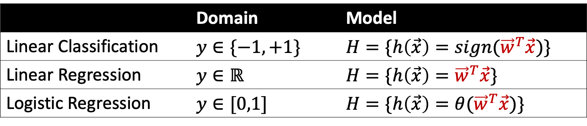
Activation Function
Think about a single neuron (linear model)
Compute the linear signal $s={\vec{w}}^{T}\vec{x}$
Transform it to what we need in the output (sign, linear, or sigmoid)
In Neural networks, outputs of some nodes are inputs of some others
Activation function decides how to do this transformation
 | Domain | Model
Linear Classification | $$y∈\{−1,+1\}$$ | $$H=\{h\left(\vec{x}\right)={sign(\vec{w}}^{T}\vec{x})\}$$
Linear Regression | $$y∈ℝ$$ | $$H=\{h\left(\vec{x}\right)={\vec{w}}^{T}\vec{x}\}$$
Logistic Regression | $$y∈[0,1]$$ | $$H=\{h\left(\vec{x}\right)={θ(\vec{w}}^{T}\vec{x})\}$$
$$θ\left(s\right)=\frac{e^{s}}{1+e^{s}}$$

Slide 17

Activation Function
Activation functions in Neural Networks
sign function:
hard to optimize
linear function:
the entire neural network is linear
One potential option: having a “softened” version of sign function
$$θ$$

Slide 18
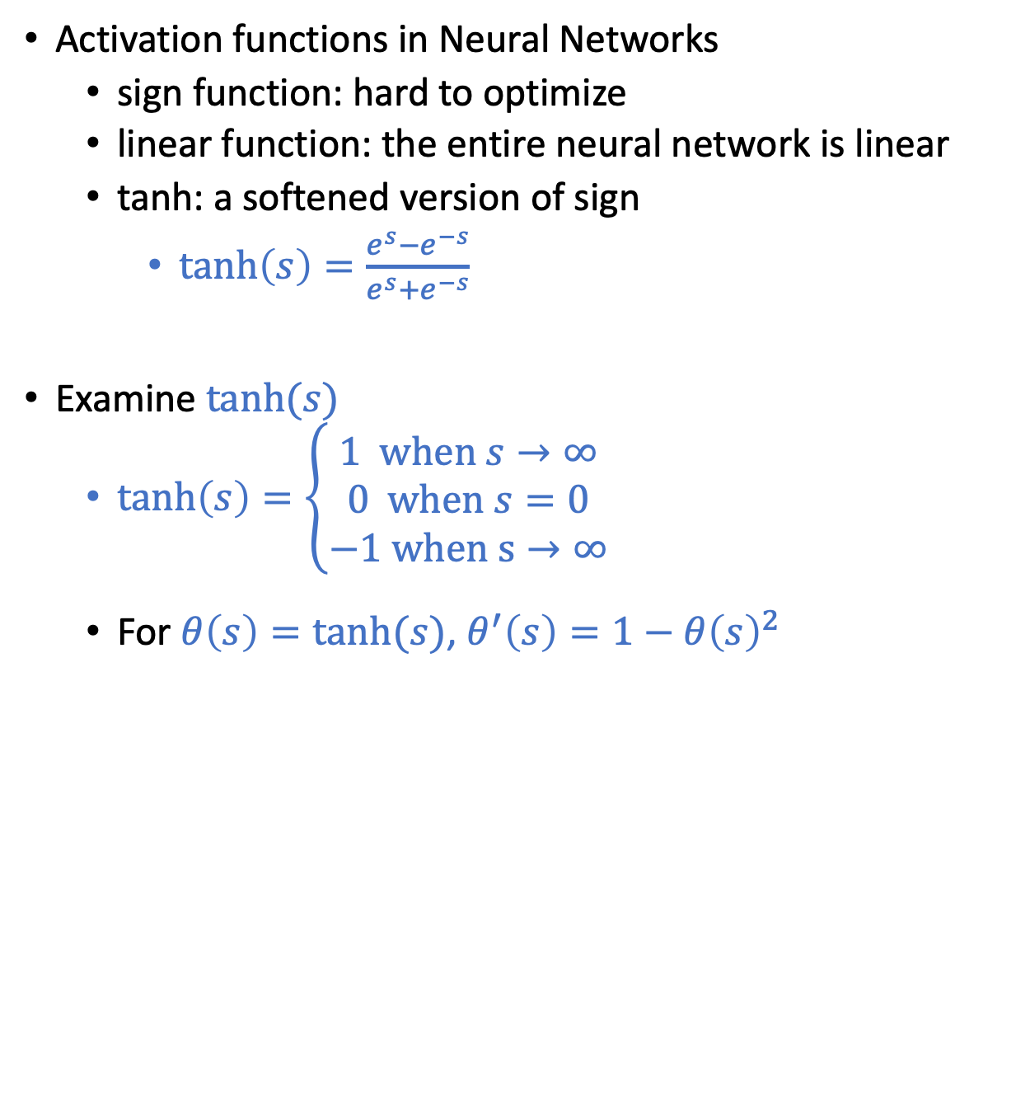
Activation Function
Activation functions in Neural Networks
sign function: hard to optimize
linear function: the entire neural network is linear
tanh: a softened version of sign
$\tanh\left(s\right)=\frac{e^{s}−e^{−s}}{e^{s}+e^{−s}}$
Examine $\tanh{(s)}$
$\tanh\left(s\right)=\left\{\begin{aligned}1 \text{when} s→∞ \\ 0 \text{when} s=0 \\ −1 \text{when} \text{s}→∞\end{aligned}\right.$
For $θ\left(s\right)=tanh⁡(s)$, $θ^{′}\left(s\right)=1−θ{\left(s\right)}^{2}$

Slide 19
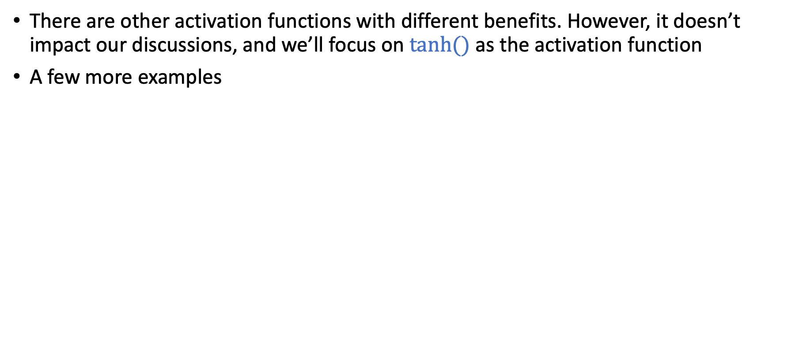
Activation Function
There are other activation functions with different benefits. However, it doesn’t impact our discussions, and we’ll focus on $tanh⁡()$ as the activation function
A few more examples
https://towardsdatascience.com/activation-functions-neural-networks-1cbd9f8d91d6

Slide 20
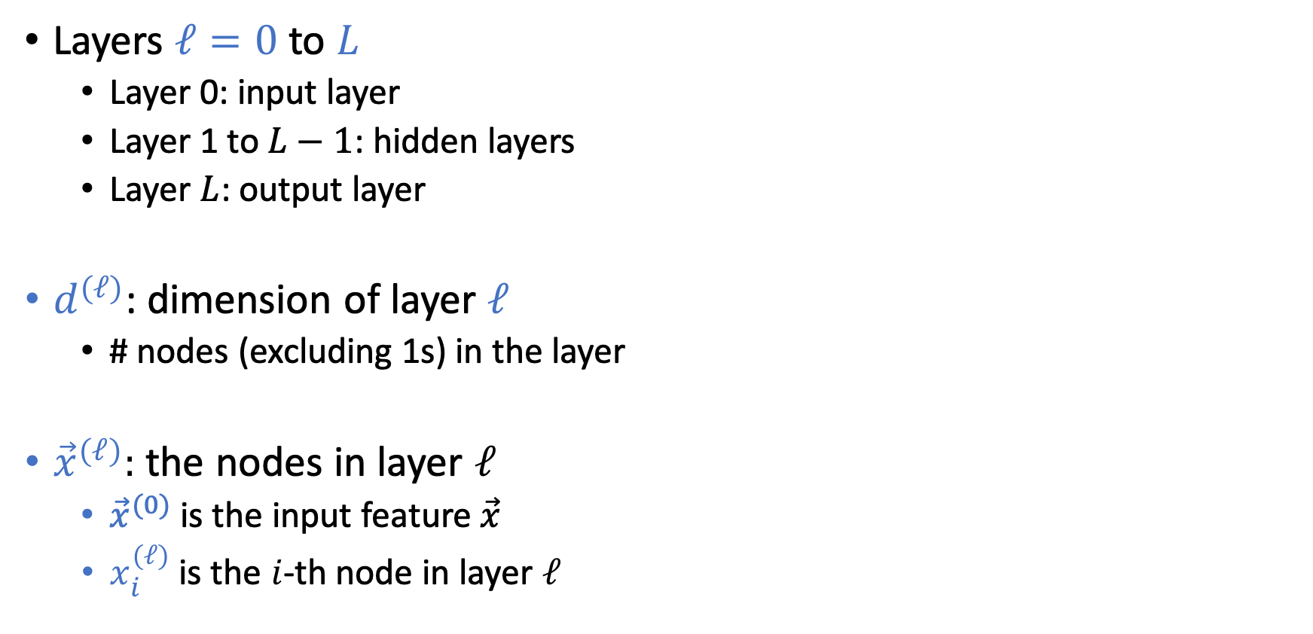
Notations of Neural Networks (NN)
Layers $ℓ=0$ to $L$
Layer 0: input layer
Layer 1 to $L−1$: hidden layers
Layer $L$: output layer
$d^{(ℓ)}$: dimension of layer $ℓ$
# nodes (excluding 1s) in the layer
${\vec{x}}^{(ℓ)}:$ the nodes in layer $ℓ$
${\vec{x}}^{(0)}$ is the input feature $\vec{x}$
$x_{i}^{(ℓ)}$ is the $i$-th node in layer $ℓ$

Slide 21
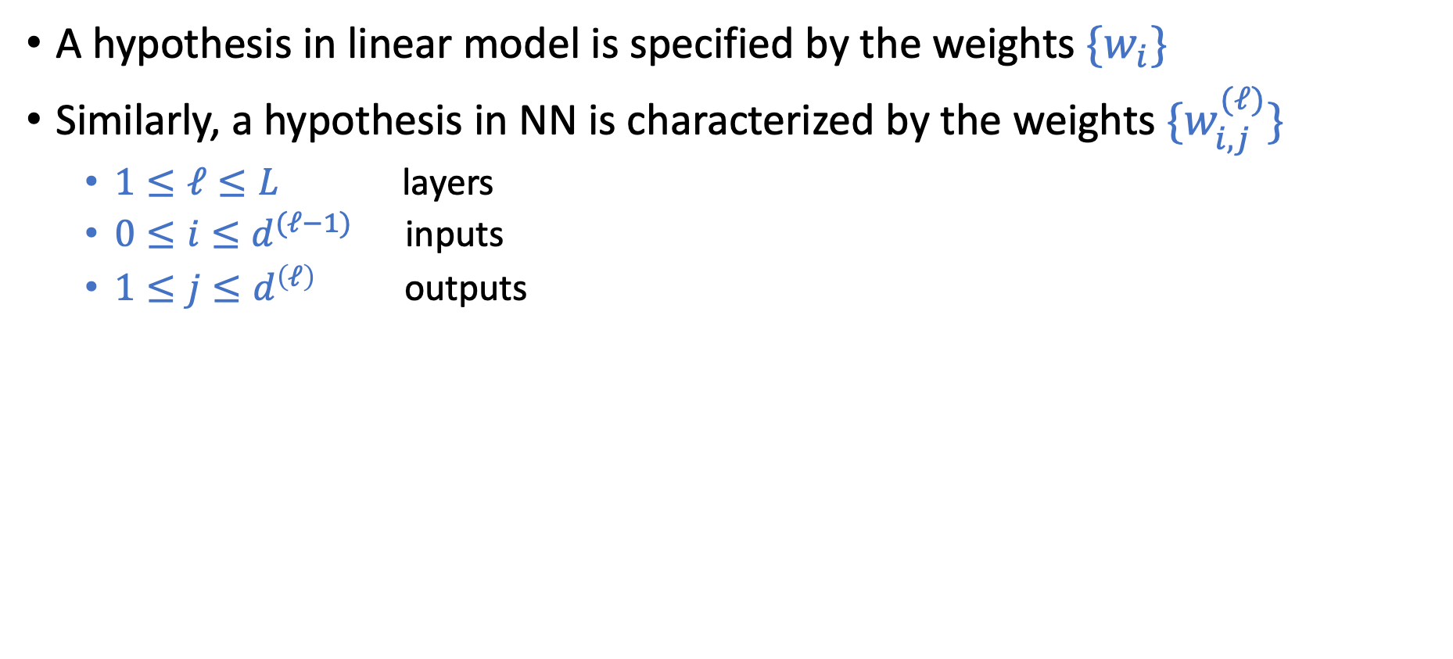
Notations of Neural Networks (NN)
A hypothesis in linear model is specified by the weights $\{w_{i}\}$
Similarly, a hypothesis in NN is characterized by the weights ${\{w}_{i,j}^{(ℓ)}\}$
$1≤ℓ≤L$ layers
$0≤i≤d^{(ℓ−1)}$ inputs
$1≤j≤d^{\left(ℓ\right)}$ outputs
Notes:
4x2 + 3x1 = 11

Slide 22
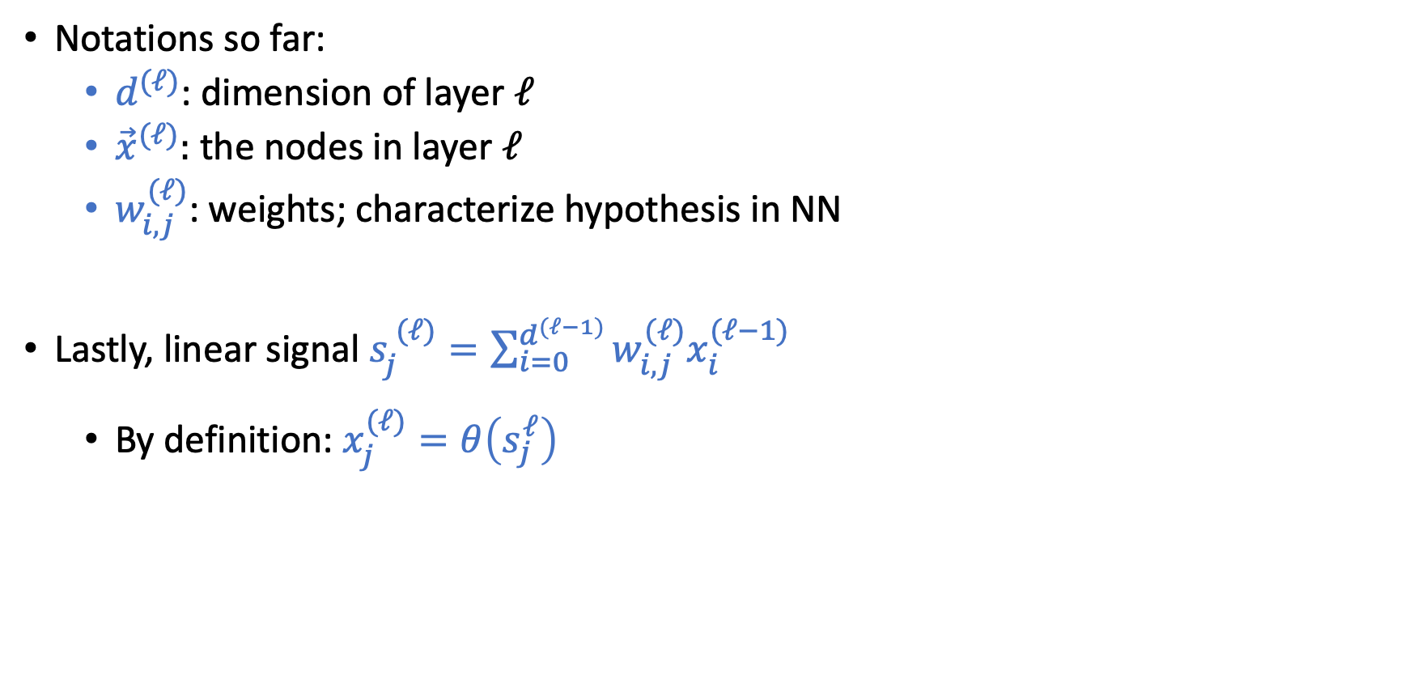
Notations of Neural Networks (NN)
Notations so far:
$d^{(ℓ)}$: dimension of layer $ℓ$
${\vec{x}}^{(ℓ)}:$ the nodes in layer $ℓ$
$w_{i,j}^{(ℓ)}$: weights; characterize hypothesis in NN
Lastly, linear signal $s_{j}^{ (ℓ)}=\sum_{i=0}^{d^{(ℓ−1)}}{w_{i,j}^{(ℓ)}x_{i}^{(ℓ−1)}}$
By definition: $x_{j}^{(ℓ)}=θ\left(s_{j}^{ℓ}\right)$
Notes:
4x2 + 3x1 = 11

Slide 23
Notations of Neural Networks (NN)
Notations so far:
$d^{(ℓ)}$: dimension of layer $ℓ$
${\vec{x}}^{(ℓ)}:$ the nodes in layer $ℓ$
$w_{i,j}^{(ℓ)}$: weights; characterize hypothesis in NN
Lastly, linear signal $s_{j}^{ (ℓ)}=\sum_{i=0}^{d^{(ℓ−1)}}{w_{i,j}^{(ℓ)}x_{i}^{(ℓ−1)}}$
By definition: $x_{j}^{(ℓ)}=θ\left(s_{j}^{ℓ}\right)$
Notes:
4x2 + 3x1 = 11

Slide 24

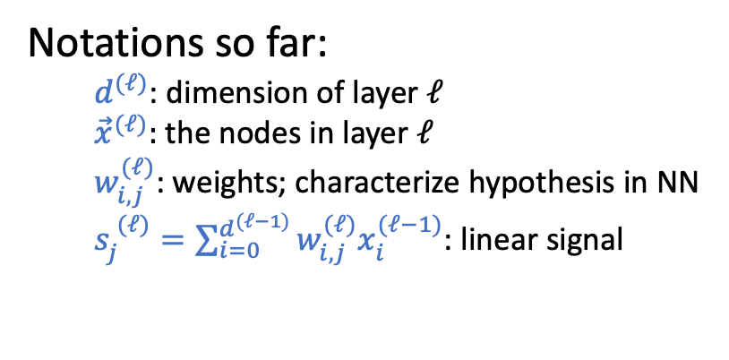
Short Break and Q&A
Practice:
For a neural network with $L=2$, $d^{(0)}=3$, $d^{(1)}=2$, $d^{(2)}=1,$ what is the total # weights?
Notations so far:
$d^{(ℓ)}$: dimension of layer $ℓ$
${\vec{x}}^{(ℓ)}:$ the nodes in layer $ℓ$
$w_{i,j}^{(ℓ)}$: weights; characterize hypothesis in NN
$s_{j}^{ (ℓ)}=\sum_{i=0}^{d^{(ℓ−1)}}{w_{i,j}^{(ℓ)}x_{i}^{(ℓ−1)}}$: linear signal
Notes:
$$4×2+3×1=11$$

Slide 25

Forward Propagation
Backpropagation
Given a NN hypothesis and a point $\vec{x}$, how do we make predictions
Learn a Neural Network hypothesis from data

Slide 26
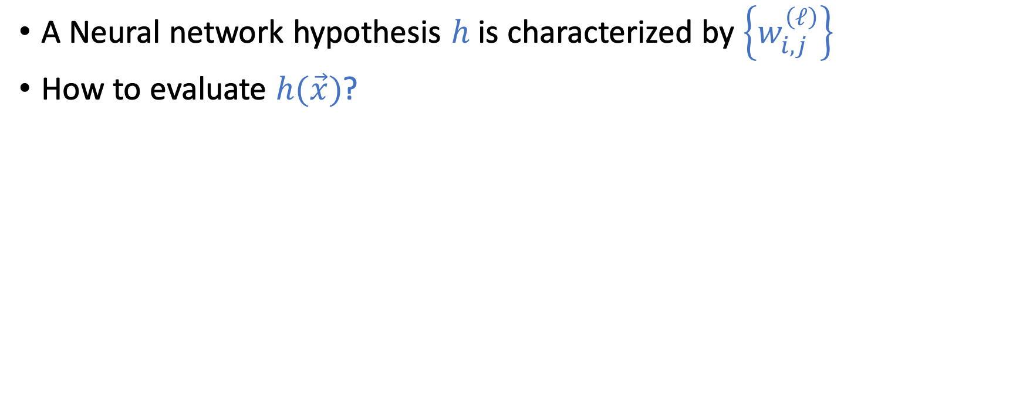
Forward Propagation
A Neural network hypothesis $h$ is characterized by $\left\{w_{i,j}^{\left(ℓ\right)}\right\}$
How to evaluate $h(\vec{x})$?

Slide 27
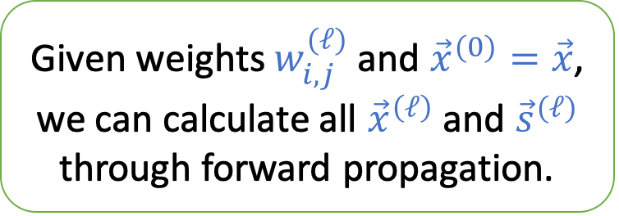
Forward Propagation
A Neural network hypothesis $h$ is characterized by $\left\{w_{i,j}^{\left(ℓ\right)}\right\}$
How to evaluate $h(\vec{x})$?
Given weights $w_{i,j}^{(ℓ)}$ and ${\vec{x}}^{(0)}=\vec{x}$, we can calculate all ${\vec{x}}^{\left(ℓ\right)}$ and ${\vec{s}}^{(ℓ)}$ through forward propagation.

Slide 28
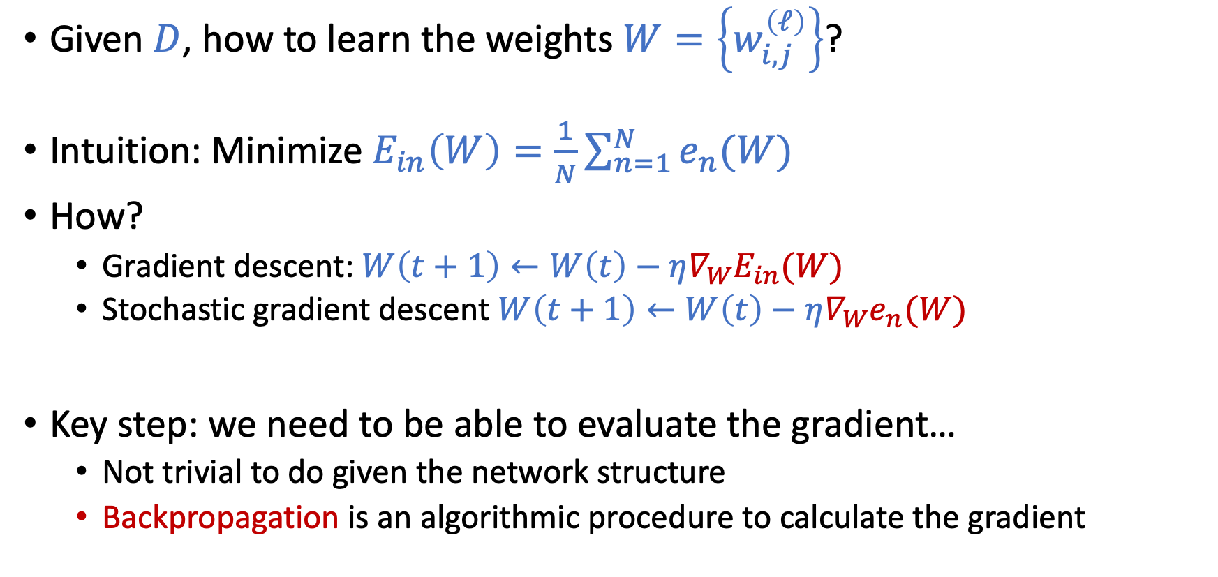
How to Learn NN From Data?
Given $D$, how to learn the weights $W=\left\{w_{i,j}^{\left(ℓ\right)}\right\}$?
Intuition: Minimize $E_{in}\left(W\right)=\frac{1}{N}\sum_{n=1}^{N}{e_{n}(W)}$
How?
Gradient descent: $W\left(t+1\right)←W\left(t\right)−η∇_{W}E_{in}(W)$
Stochastic gradient descent $W\left(t+1\right)←W\left(t\right)−η∇_{W}e_{n}(W)$
Key step: we need to be able to evaluate the gradient…
Not trivial to do given the network structure
Backpropagation is an algorithmic procedure to calculate the gradient

Slide 29
Backpropagation
Use dynamic programming to evaluate the gradient

Slide 30
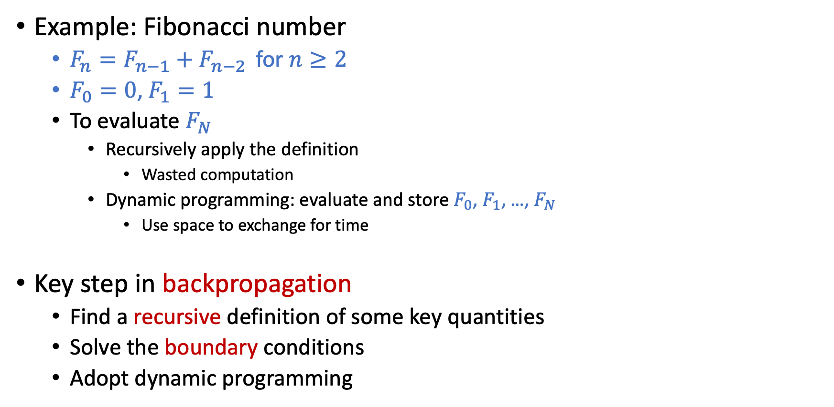
Quick Reminders on Dynamic Programming
Example: Fibonacci number
$F_{n}=F_{n−1}+F_{n−2 }$ for $n≥2$
$F_{0}=0$, $F_{1}=1$
To evaluate $F_{N}$
Recursively apply the definition
Wasted computation
Dynamic programming: evaluate and store $F_{0}$, $F_{1}$, …, $F_{N}$
Use space to exchange for time
Key step in backpropagation
Find a recursive definition of some key quantities
Solve the boundary conditions
Adopt dynamic programming

Slide 31
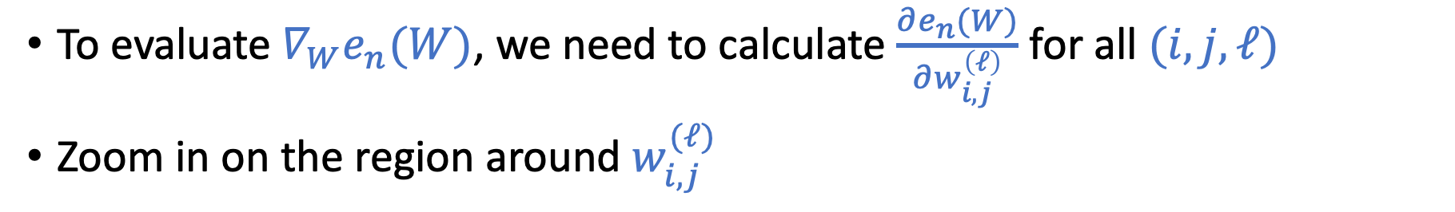

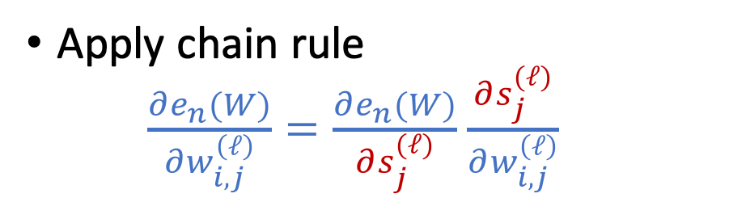
Compute the Gradient $∇_{W}e_{n}(W)$
To evaluate $∇_{W}e_{n}(W)$, we need to calculate $\frac{∂e_{n}(W)}{∂w_{i,j}^{\left(ℓ\right)}}$ for all $(i,j,ℓ)$
Zoom in on the region around $w_{i,j}^{(ℓ)}$
Apply chain rule $\frac{∂e_{n}(W)}{∂w_{i,j}^{\left(ℓ\right)}}=\frac{∂e_{n}(W)}{∂s_{j}^{(ℓ)}}$ $\frac{∂s_{j}^{(ℓ)}}{∂w_{i,j}^{\left(ℓ\right)}}$

Slide 32
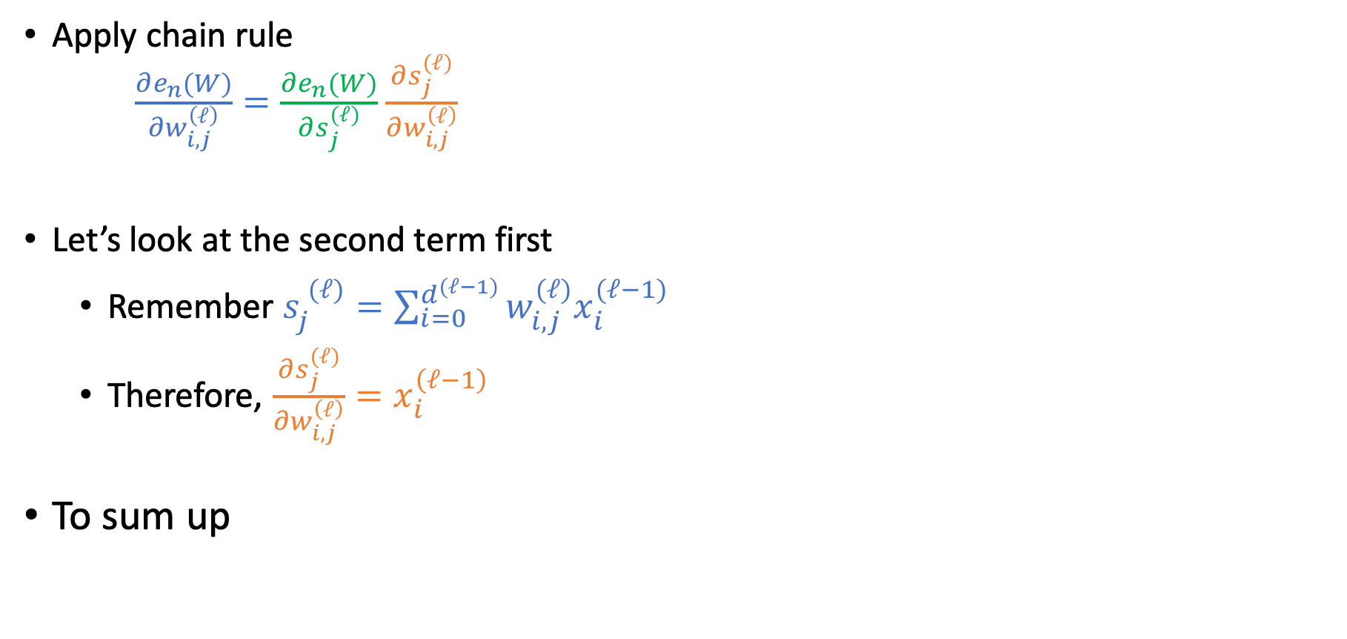
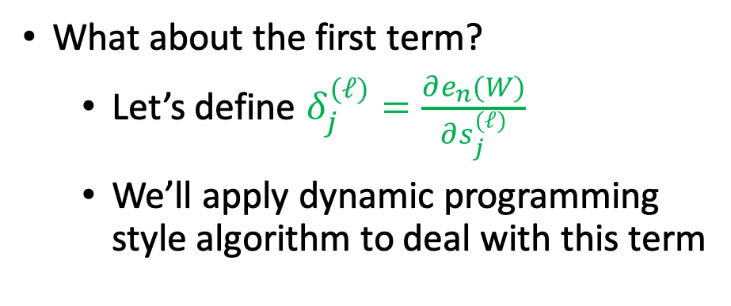
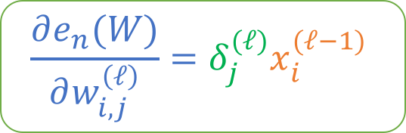
Compute the Gradient $∇_{W}e_{n}(W)$
Apply chain rule $\frac{∂e_{n}(W)}{∂w_{i,j}^{\left(ℓ\right)}}=\frac{∂e_{n}(W)}{∂s_{j}^{(ℓ)}}$ $\frac{∂s_{j}^{(ℓ)}}{∂w_{i,j}^{\left(ℓ\right)}}$
Let’s look at the second term first
Remember $s_{j}^{ (ℓ)}=\sum_{i=0}^{d^{(ℓ−1)}}{w_{i,j}^{(ℓ)}x_{i}^{(ℓ−1)}}$
Therefore, $\frac{∂s_{j}^{(ℓ)}}{∂w_{i,j}^{\left(ℓ\right)}}=x_{i}^{\left(ℓ−1\right)}$
To sum up
What about the first term?
Let’s define $δ_{j}^{(ℓ)}=\frac{∂e_{n}(W)}{∂s_{j}^{(ℓ)}}$
We’ll apply dynamic programming style algorithm to deal with this term
$$\frac{∂e_{n}(W)}{∂w_{i,j}^{\left(ℓ\right)}}=δ_{j}^{(ℓ)}x_{i}^{(ℓ−1)}$$

Slide 33
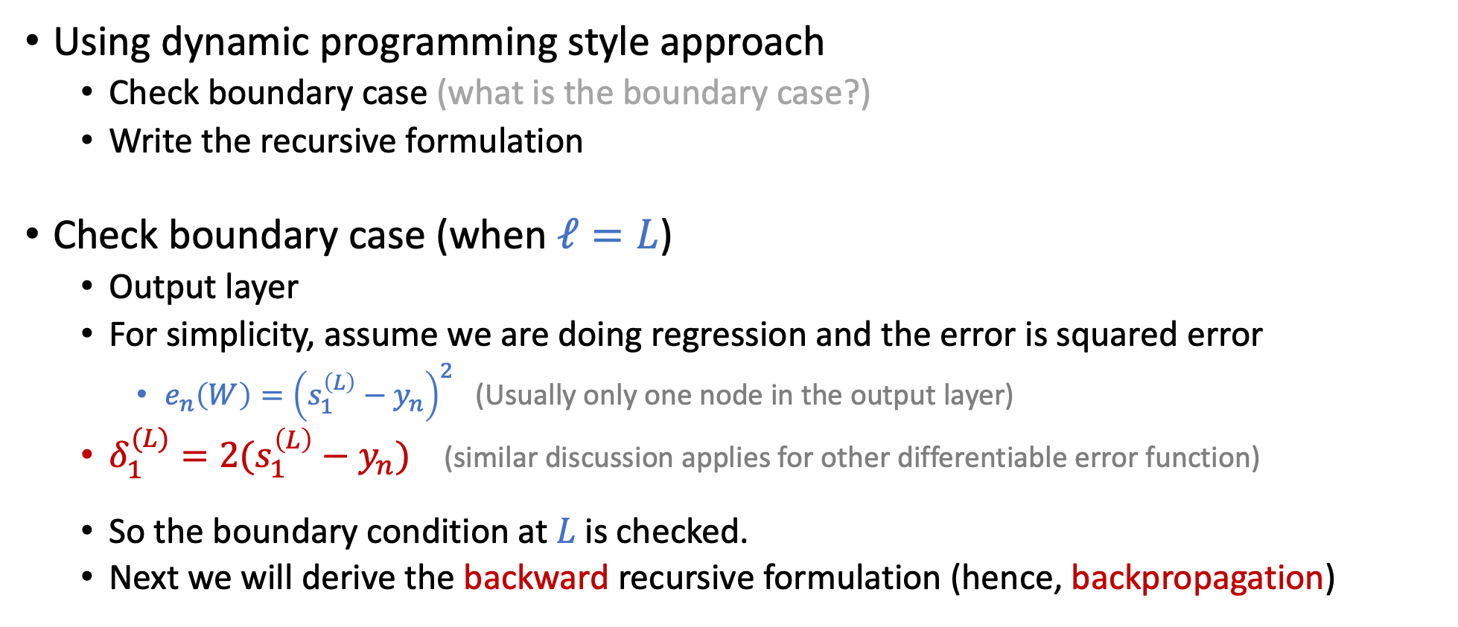

Compute $δ_{j}^{(ℓ)}=\frac{∂e_{n}(W)}{∂s_{j}^{(ℓ)}}$
Using dynamic programming style approach
Check boundary case (what is the boundary case?)
Write the recursive formulation
Check boundary case (when $ℓ=L$)
Output layer
For simplicity, assume we are doing regression and the error is squared error
$e_{n}\left(W\right)={\left(s_{1}^{\left(L\right)}−y_{n}\right)}^{2}$ (Usually only one node in the output layer)
$δ_{1}^{(L)}=2(s_{1}^{\left(L\right)}−y_{n})$ (similar discussion applies for other differentiable error function)
So the boundary condition at $L$is checked.
Next we will derive the backward recursive formulation (hence, backpropagation)

Slide 34

Compute $δ_{j}^{(ℓ)}=\frac{∂e_{n}(W)}{∂s_{j}^{(ℓ)}}$
Zoom in to see the chain of dependencies

Slide 35
Compute $δ_{j}^{(ℓ)}=\frac{∂e_{n}(W)}{∂s_{j}^{(ℓ)}}$
Zoom in to see the chain of dependencies

Slide 36

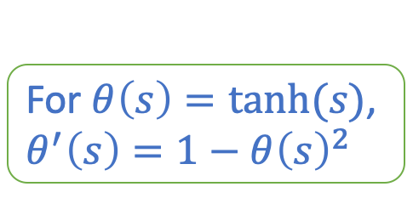
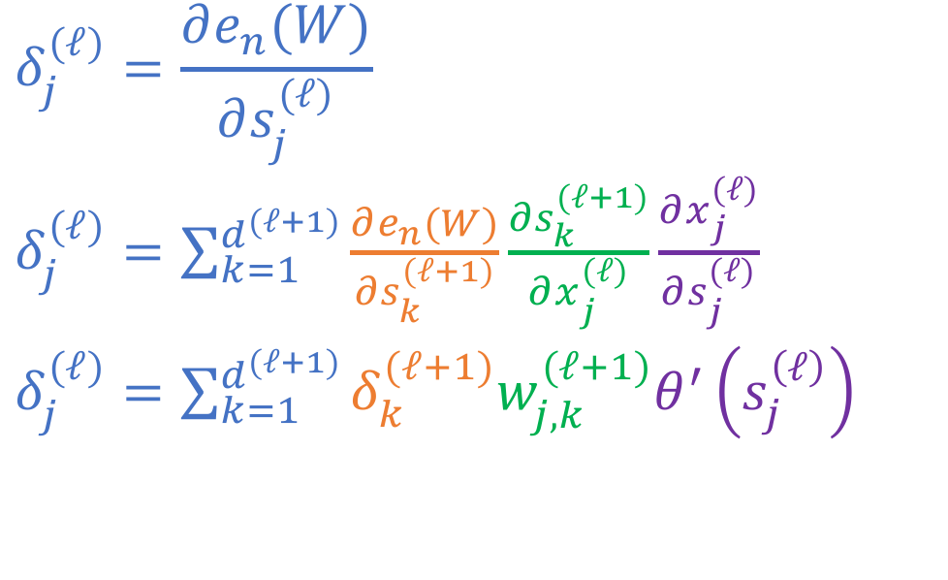
Compute $δ_{j}^{(ℓ)}=\frac{∂e_{n}(W)}{∂s_{j}^{(ℓ)}}$
Zoom in to see the chain of dependencies
For $θ\left(s\right)=tanh⁡(s)$, $θ^{′}\left(s\right)=1−θ{\left(s\right)}^{2}$
$$δ_{j}^{(ℓ)}=\frac{∂e_{n}(W)}{∂s_{j}^{(ℓ)}}$$
$δ_{j}^{(ℓ)}=\sum_{k=1}^{d^{(ℓ+1)}}{\frac{∂e_{n}(W)}{∂s_{k}^{(ℓ+1)}}\frac{∂s_{k}^{(ℓ+1)}}{∂x_{j}^{(ℓ)}}\frac{∂x_{j}^{(ℓ)}}{∂s_{j}^{(ℓ)}}}$
$δ_{j}^{(ℓ)}=\sum_{k=1}^{d^{(ℓ+1)}}{δ_{k}^{(ℓ+1)}w_{j,k}^{(ℓ+1)}θ^{′}\left(s_{j}^{\left(ℓ\right)}\right)}$
We have the backward recurve definition!

Slide 37
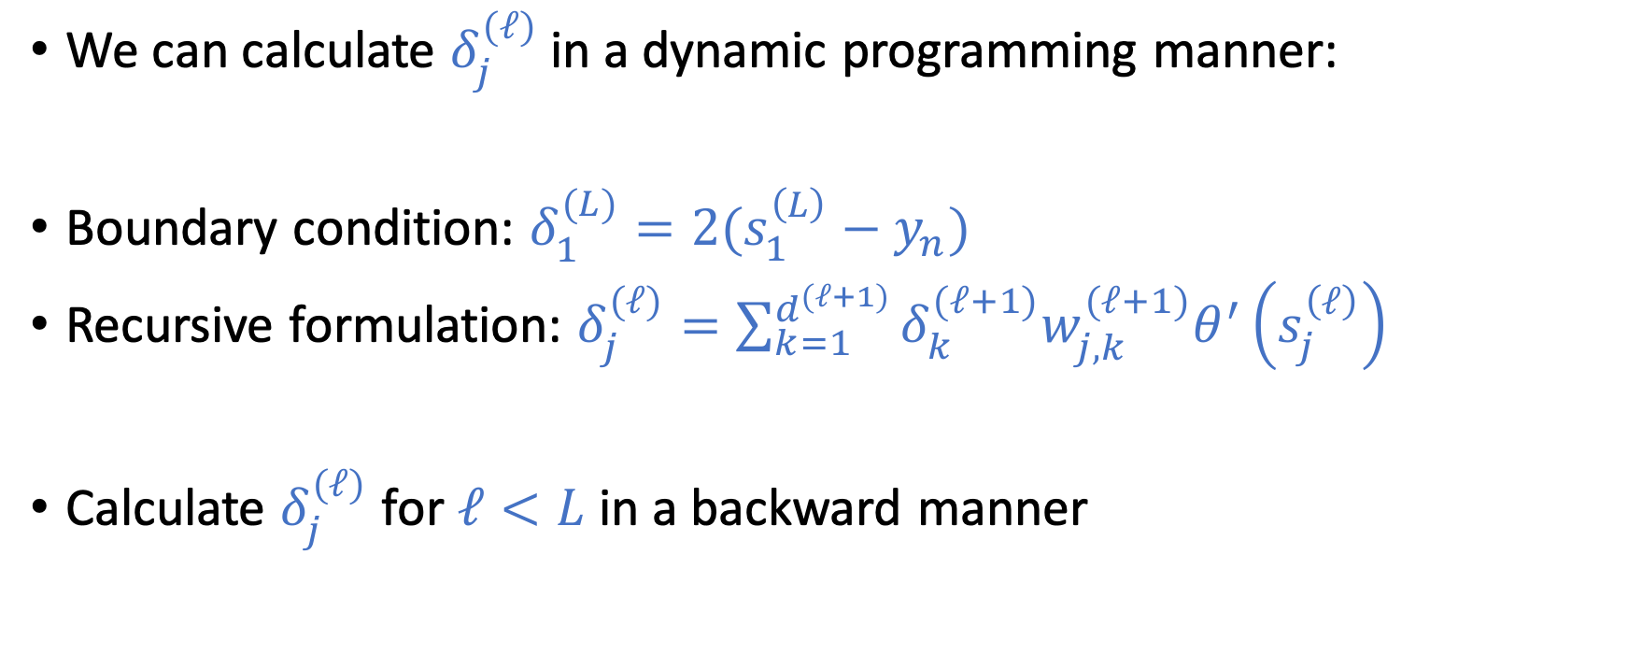
Compute $δ_{j}^{(ℓ)}=\frac{∂e_{n}(W)}{∂s_{j}^{(ℓ)}}$
We can calculate $δ_{j}^{(ℓ)}$ in a dynamic programming manner:
Boundary condition: $δ_{1}^{(L)}=2(s_{1}^{\left(L\right)}−y_{n})$
Recursive formulation: $δ_{j}^{(ℓ)}=\sum_{k=1}^{d^{(ℓ+1)}}{δ_{k}^{(ℓ+1)}w_{j,k}^{(ℓ+1)}θ^{′}\left(s_{j}^{\left(ℓ\right)}\right)}$
Calculate $δ_{j}^{(ℓ)}$ for $ℓ<L$ in a backward manner

Slide 38
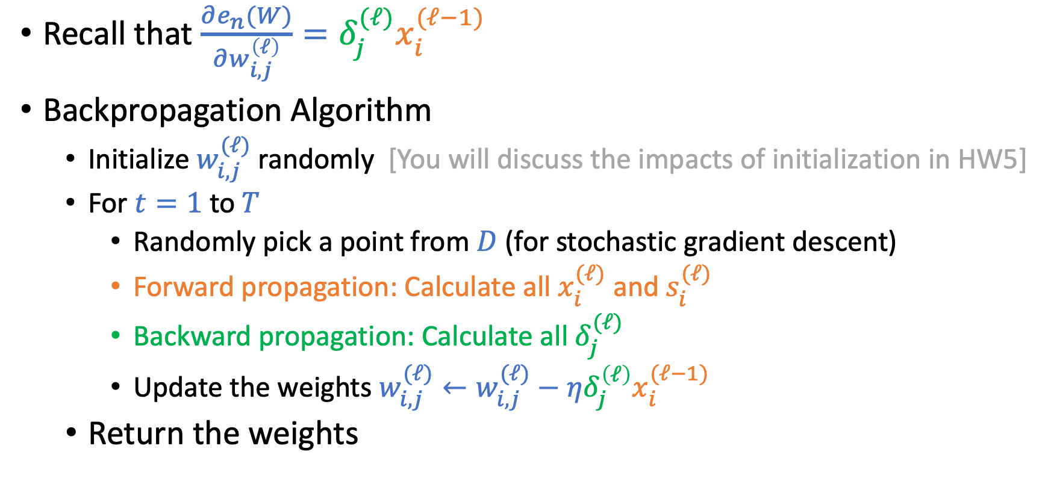
Backpropagation Algorithm
Recall that $\frac{∂e_{n}(W)}{∂w_{i,j}^{\left(ℓ\right)}}=δ_{j}^{(ℓ)}x_{i}^{(ℓ−1)}$
Backpropagation Algorithm
Initialize $w_{i,j}^{(ℓ)}$randomly [You will discuss the impacts of initialization in HW5]
For $t=1$ to $T$
Randomly pick a point from $D$ (for stochastic gradient descent)
Forward propagation: Calculate all $x_{i}^{(ℓ)}$ and $s_{i}^{(ℓ)}$
Backward propagation: Calculate all $δ_{j}^{(ℓ)}$
Update the weights $w_{i,j}^{(ℓ)}←w_{i,j}^{(ℓ)}−η{δ_{j}^{\left(ℓ\right)}x}_{i}^{(ℓ−1)}$
Return the weights

Slide 39
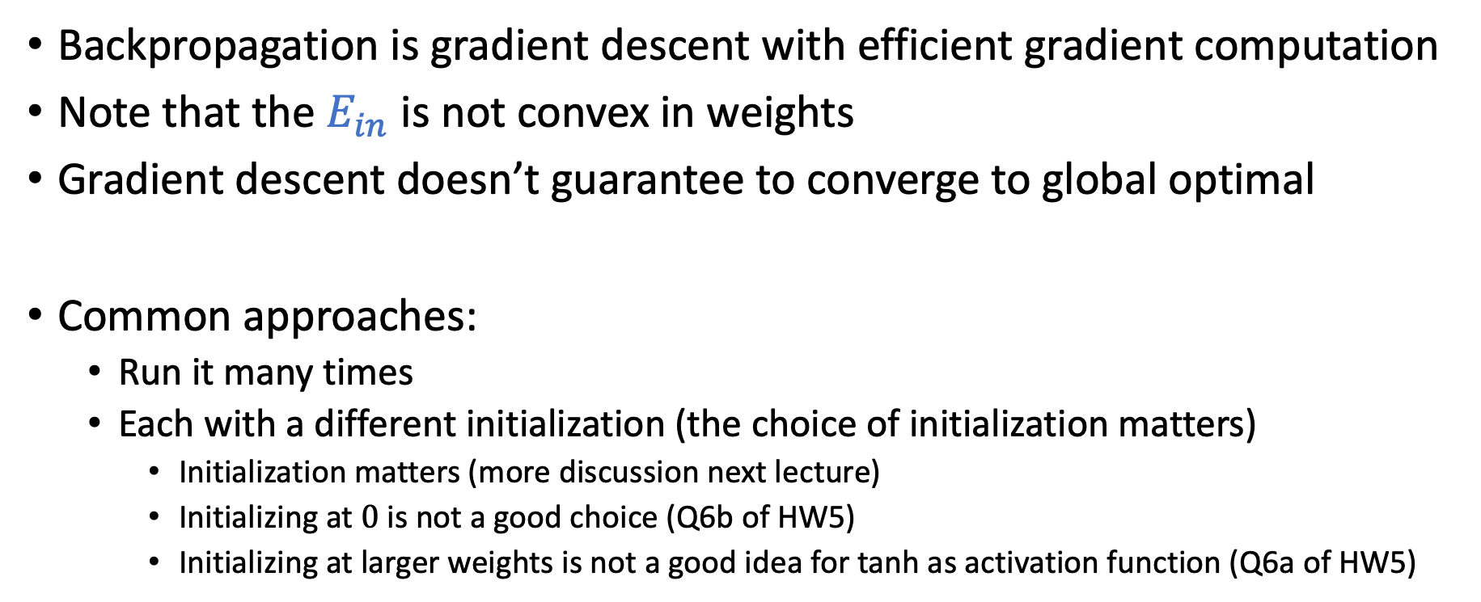
Discussion
Backpropagation is gradient descent with efficient gradient computation
Note that the $E_{in}$ is not convex in weights
Gradient descent doesn’t guarantee to converge to global optimal
Common approaches:
Run it many times
Each with a different initialization (the choice of initialization matters)
Initialization matters (more discussion next lecture)
Initializing at $0$ is not a good choice (Q6b of HW5)
Initializing at larger weights is not a good idea for tanh as activation function (Q6a of HW5)

Slide 40
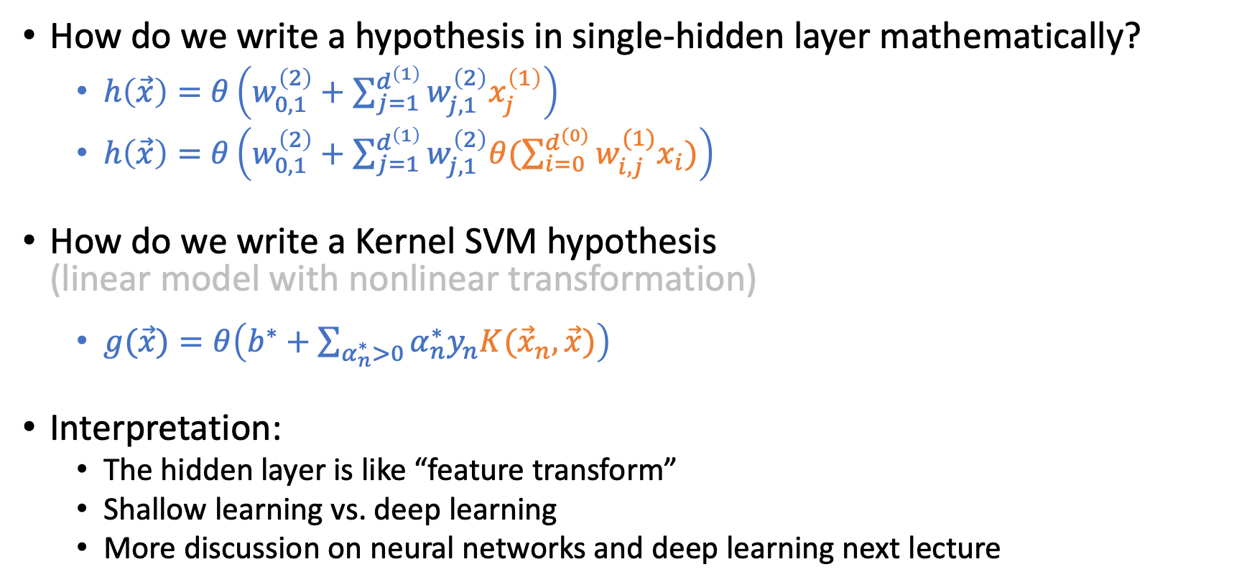
Single Hidden-Layer Neural Network
How do we write a hypothesis in single-hidden layer mathematically?
$h\left(\vec{x}\right)=θ\left(w_{0,1}^{\left(2\right)}+\sum_{j=1}^{d^{\left(1\right)}}{w_{j,1}^{\left(2\right)}x_{j}^{\left(1\right)}}\right)$
$h\left(\vec{x}\right)=θ\left(w_{0,1}^{\left(2\right)}+\sum_{j=1}^{d^{\left(1\right)}}{w_{j,1}^{\left(2\right)}θ(\sum_{i=0}^{d^{(0)}}{w_{i,j}^{(1)}x_{i}})}\right)$
How do we write a Kernel SVM hypothesis (linear model with nonlinear transformation)
$g(\vec{x})=θ\left(b^{∗}+\sum_{α_{n}^{∗}>0}{α_{n}^{∗}y_{n}K({\vec{x}}_{n},\vec{x})}\right)$
Interpretation:
The hidden layer is like “feature transform”
Shallow learning vs. deep learning
More discussion on neural networks and deep learning next lecture

